Slide 1
Principles of Drug Discovery
Lecture 1 - Introduction

Slide 2
Language?

Slide 3
Your Lecturer
Daniel Seeliger
Diploma in Chemistry, University of Ulm (1998-2003)
PhD Max-Planck-Institute for Biophysical Chemistry Göttingen (2004-2008)
PostDoc Max-Planck-Institute for Biophysical Chemistry Göttingen (2008-2010)
Boehringer Ingelheim Pharma GmbH & Co KG Biberach, Department of Medicinal Chemistry, Computational Chemistry Group (since 2010)

Slide 4
Goal of this Lecture
Convey a basic understanding of how modern drug discovery works
What you should know already
Basic organic chemistry
Basic physical chemistry
Basic math

Slide 5
Content
Protein structures and drug targets – Where and how do drugs interact?
Protein/Ligand interactions – What determines molecular recognition?
Hit finding - How do we find initial starting points for new drugs?
Chemical optimization – What are the important properties of a drug molecule and how are they optimized

Slide 6
What this lecture will not cover
Specific diseases and their pharmacological treatment
Synthetic organic chemistry

Slide 7
Materials
There is no single book which covers all the content of this lecture
Slides will be available online (Moodle, Dropbox, Slideshare)

Slide 8
Text books from which many figures and examples are taken

Slide 9
Examination
Written or oral examination depending on number of participants (end of July)

Slide 10
Questions?

Slide 11
Historical Drug Discovery

Slide 12
Alexander Fleming, London, Nobelprize for Physiology and Medicine 1945
Penicillin

Slide 13
Ergot fungus
Albert Hofmann, Sandoz, Basel
Lysergic acid diethylamide (LSD)

Slide 14
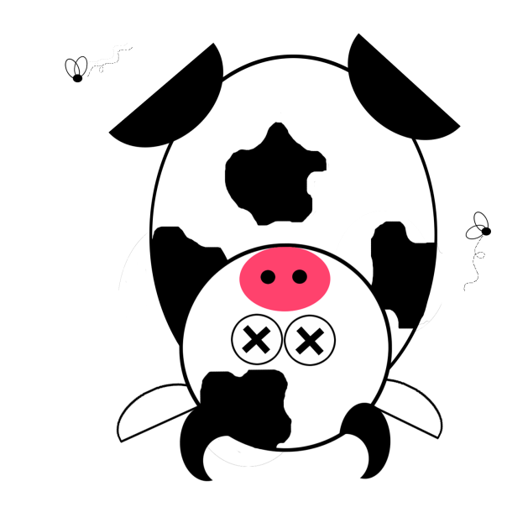
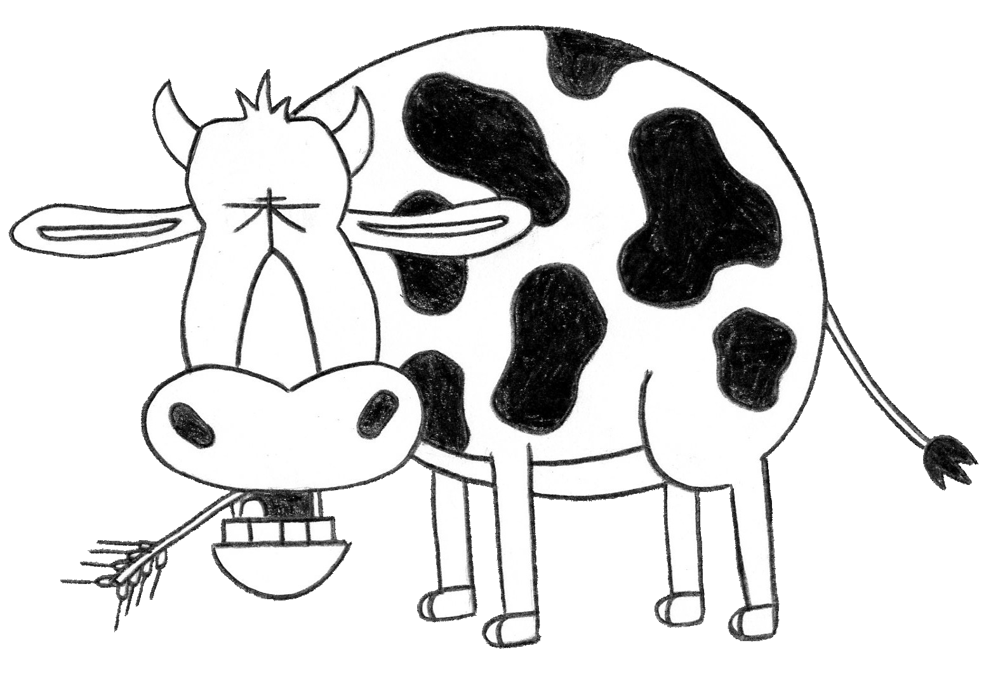
Cattle, 1920s, North Dakota
Dead Cattle, 1920s, North Dakota
Fungi
CH₂O
Coumarin
4-Hydroxy-Coumarin
Di-Coumarol
Strong anti-coagulant

Slide 15

Observation of a pharmacological effect
Accident
(Decaying Hay)
Link of the pharmacological effect to a substance
Chemical variation of the substance
Treatment of diseases
Warfarin

Slide 16
Warfarin has a strong anti-coagulant effect (prevention of blood clotting)
Warfarin
It has been successfully used for decades to prevent strokes in patients with an increased risk for strokes
It’s second major use case is as rat poison

Slide 17
Drug Discovery until the 1970s was largely driven by serendipity
Revolutionary molecular biology discoveries in the 1970s and 80s have initiated a new era for drug discovery
DNA and RNA sequencing
PCR technology (polymerase chain reaction)
Recombinant DNA technology
Production of proteins in E.coli and other cell lines
Development of in-vitro assays mimicking biological systems

Slide 18
Modern Drug Discovery

Slide 19
Modern Drug Discovery – The Target Centric View
Connection between the disease and molecular mechanisms
Disease
Definition of „drug targets“
Approval for Treatment
Clinical evaluation of the new drug
Search for molecules which act on the drug target

Slide 20
How does the pharmaceutical industry decide in which disease areas to work on?
Unmet Medical Need
How well can certain disease be treated with the current standard of care/available medication?
Market Potential
How big is the patient population that could benefit from a new treatment?
How well are health care systems developed in countries with significant patent population?
If patient population is low (rare diseases), which price can be achieved for a new medication?
Research Feasibility
How well is the disease understood?
Are relevant in-vitro systems and animal models available?

Slide 21
Starting point for a modern drug discovery project is the understanding of a disease-related molecular mechanism.
The concept of drug targets is a hallmark of modern drug discovery. Projects are usually ”target-centric”.
One disease is usually tackled by many different targets and drug discovery projects.

Slide 22
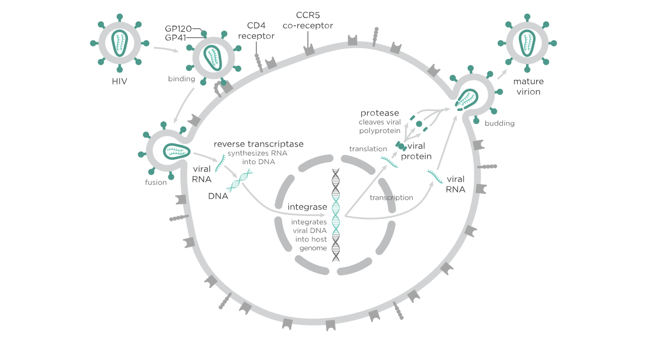
The Life Cycle of the HI Virus
Blocking a step in the virus life cycle stops viral reproduction

Slide 23
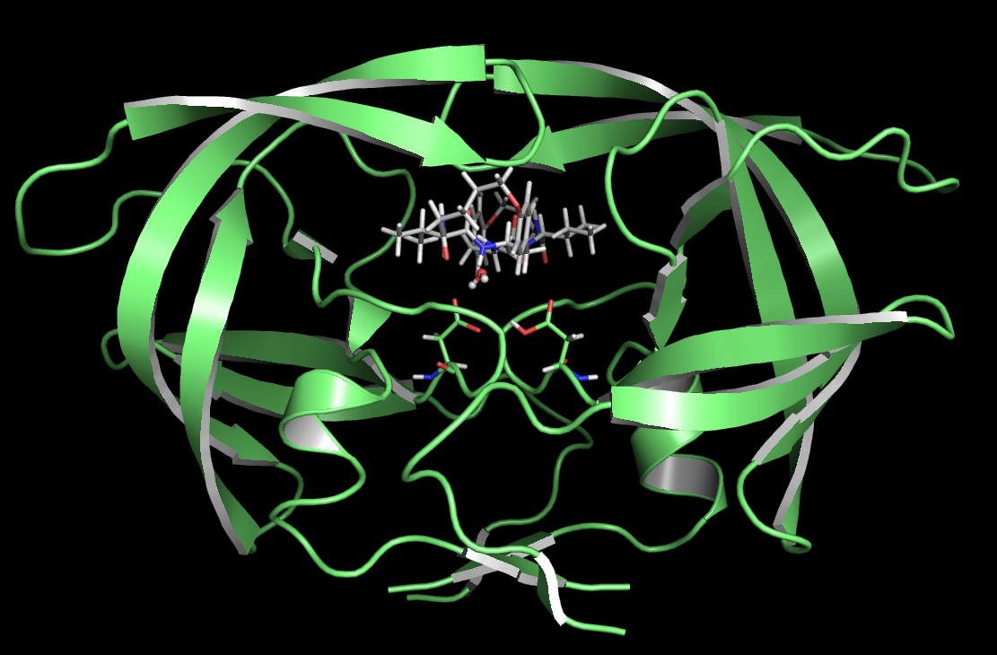
HIV Protease
Xray Structure of HIV1 Protease (Cartoon representation)

Slide 24
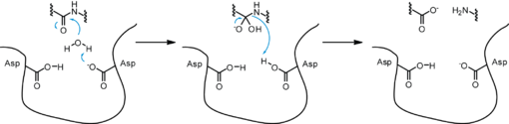
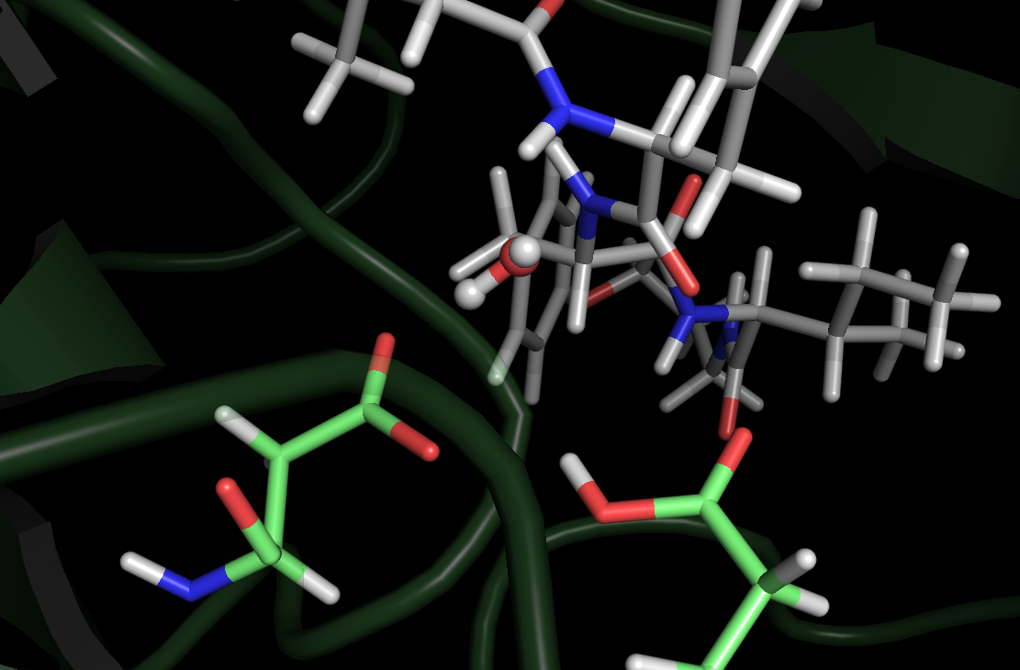

Slide 25
The Link between a Target and a Disease
Therapeutic goal
Lowering of the viral reproduction rate will slow down or even halt the progression to AIDS.
Cleavage of the HIV poly-protein is essential for viral reproduction.
Understand the biological mechanism on a molecular level
Inhibition of the catalytic mechanism will prevent viral reproduction.
Propose drug target
Many drug discovery programs fail because the hypothesis about the target/disease link turns out to be wrong!

Slide 26
Once a drug target has been identified the actual drug discovery project starts
Its goal is to identify a new molecular entity which interferes with the target and modulates its biological function in the desired way

Slide 27
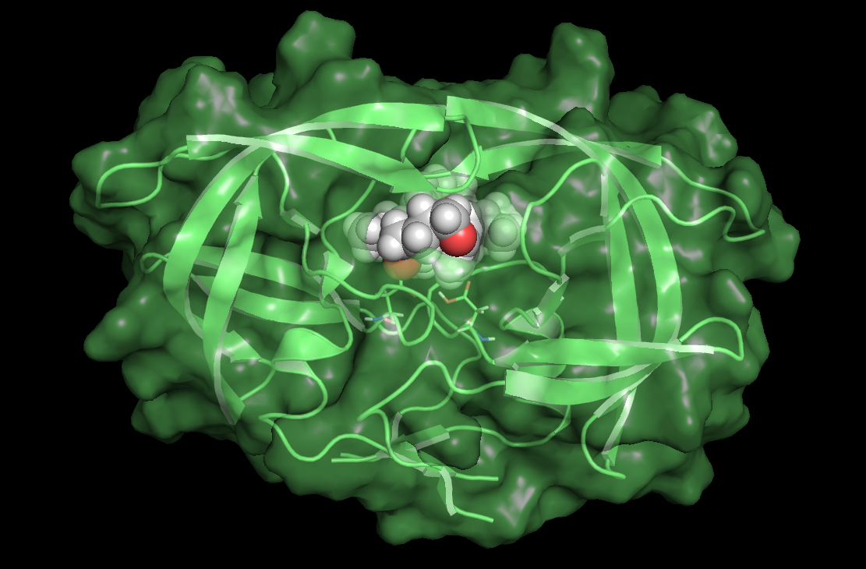

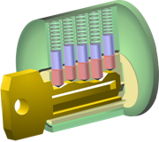
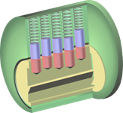
HIV-1 Protease Inhibitors
Inhibitors:
Bind with high affinity to the active site of the enzyme
Prevent entry and cleavage of the normal substrate of the enzyme

Slide 28
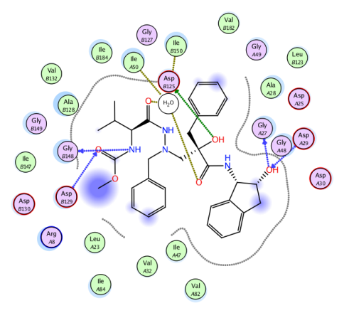
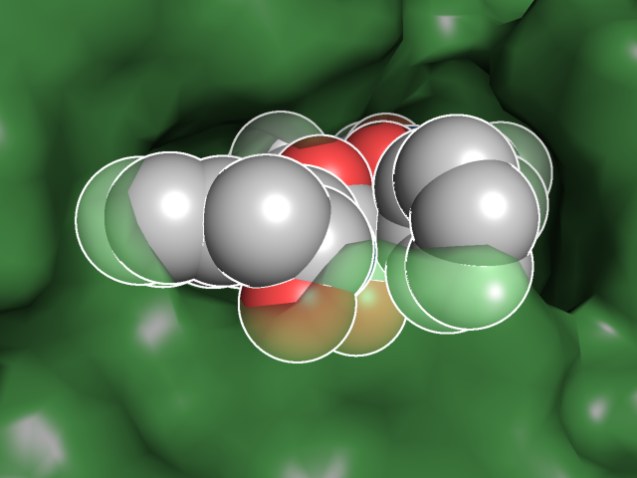
Inhibition of Drug Targets - Molecular Interactions
Principle of Drug Design:
Find and design molecules which are able to form multiple favorable interactions with the target, which are complementary in shape and which modulate its biological function.

Slide 29
Drug Discovery and Development
Discovery Research
Clinical Development
Approval
10-12 years

Slide 30
Drug Discovery Projects
Discovery Research
Target Discovery
Hit Finding
Lead Optimization
This Lecture

Slide 31
Drug Discovery Projects
Clinical Development
Approval
Phase I
Phase II
Phase III

Slide 32
Clinical Trials: Phase I
Few (20-100) healthy, (male) participants
Goals:
Safety
Tolerability
Pharmacokinetics

Slide 33
Clinical Trials: Phase II
100-300 patients
Goals:
Safety
Tolerability
Pharmacokinetics
Efficacy (Proof-of-concept)
Dose-finding

Slide 34
Clinical Trials: Phase III
300-3000 patients (in some cases more)
Goals:
Safety
Tolerability
Effectiveness (how does the drug work in the relevant patient population compared to the standard of care)

Slide 35
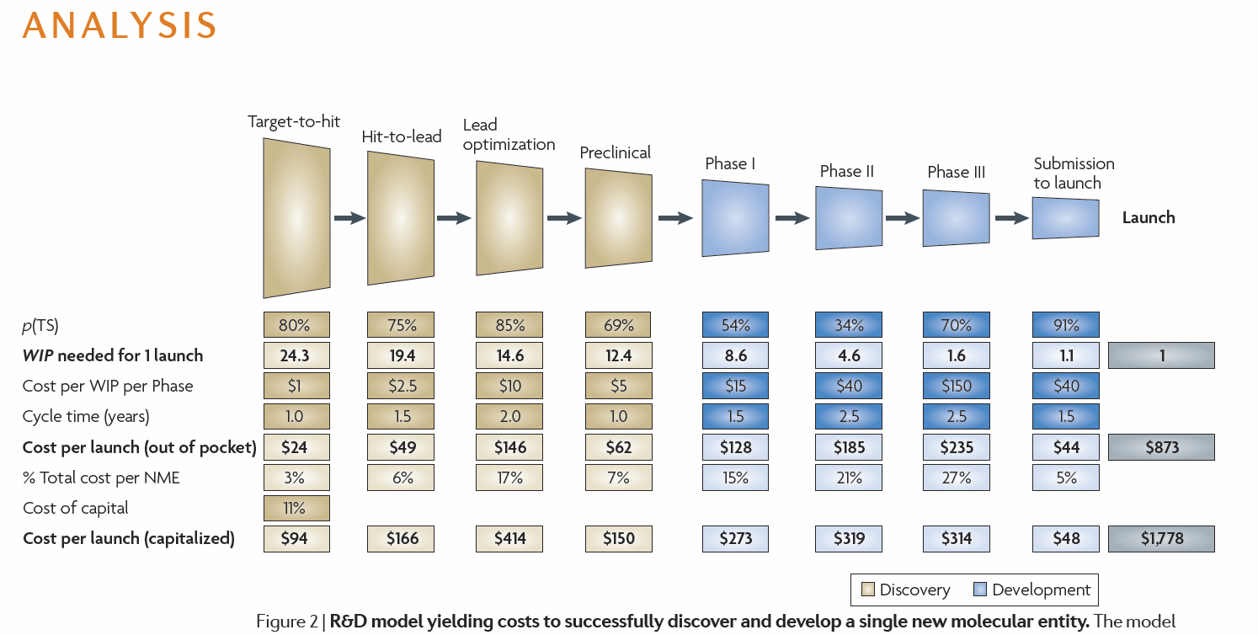

Slide 36
Summary
Historical drug discovery was largely a matter of serendipidy.
Modern drug discovery aims at understanding diseases by means of biological mechanisms.
Drug discovery since the 1990s is mainly target centric. Drug targets are proteins which play key roles in biological mechanisms.
Next Lecture: Protein Structure and Function

Slide 37
Questions?

